Slide 1
Mesa DND
Individual Project
By Christian Redfern

Slide 2
Introduction
With this project, I set out to create a Spring Boot application with a back-end in Java and a front-end in JavaScript, connected to a MySQL Database on GCP.
The project needed to be sufficiently planned, version controlled, utilising a CI Pipeline, built and deployed using Maven and with sufficient documentation.

Slide 3
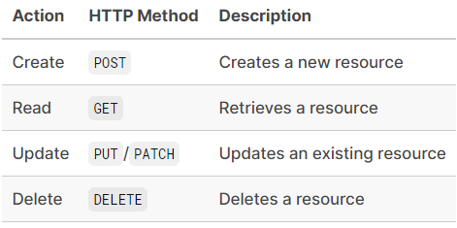
Minimum Viable Product
The MVP is an application with full CRUD functionality, a working back-end and front-end, and extensive testing.
Testing requires at least 80% coverage.
The MVP isn’t great in scope, though is open-ended enough to be expanded upon far beyond these requirements.

Slide 4
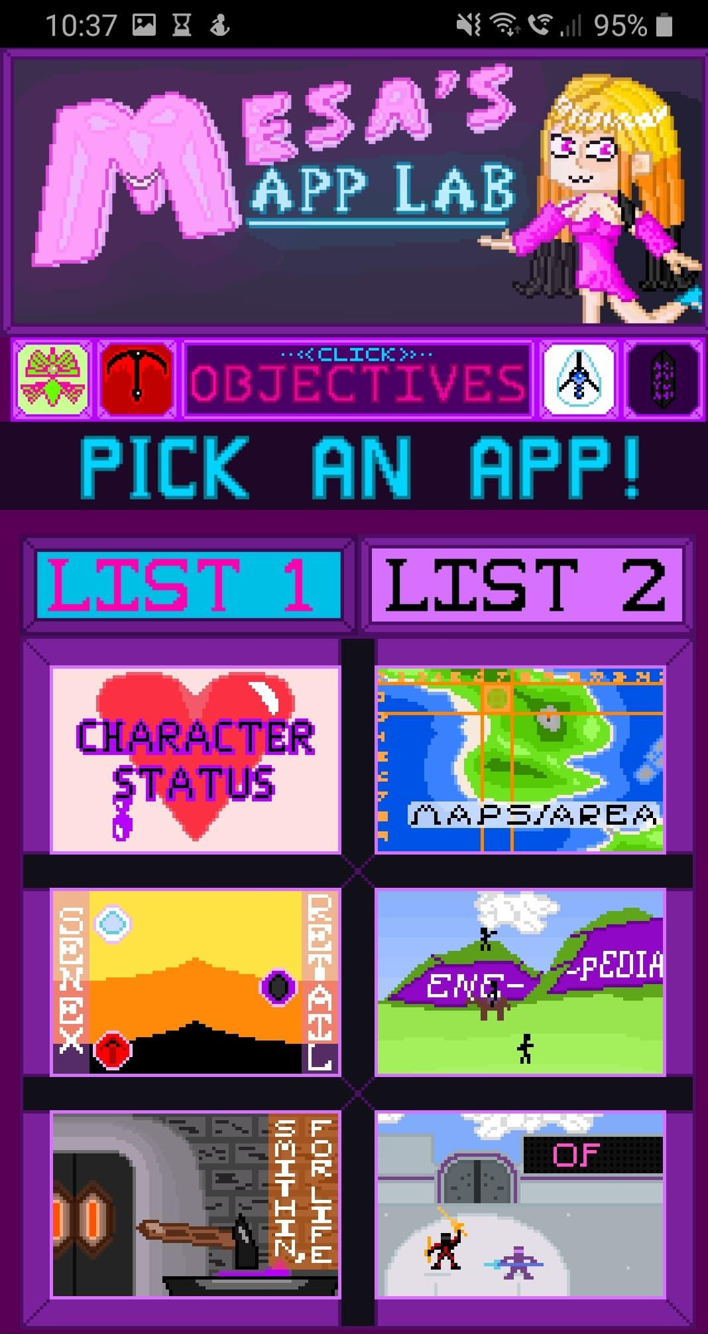
Concept
The product I chose was a Dungeons and Dragons Character Sheet Maker and Reader.
It’s derived from a PhoneGap Web Application called Mesa’s App Lab.
Reasons for choosing this hobby:
It works as an application.
It’s a chance to make an improved version of an old project.
I can reuse visual assets from Mesa’s App Lab.

Slide 5
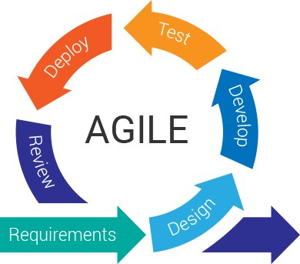
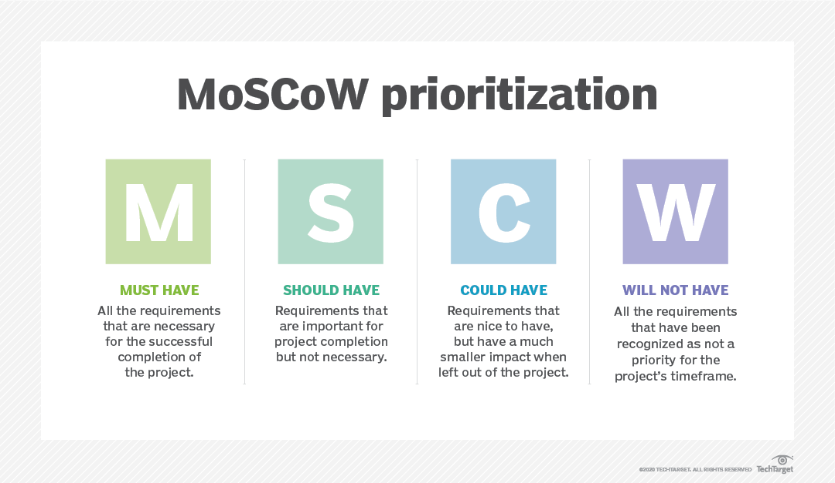
Agile
The project’s development followed the Agile Methodology.
Every day spent developing the project, I’d check the Kanban Board created using GitHub’s project feature and work on the most important features.
This was further built upon by utilising the MoSCoW Method of Prioritisation.

Slide 6
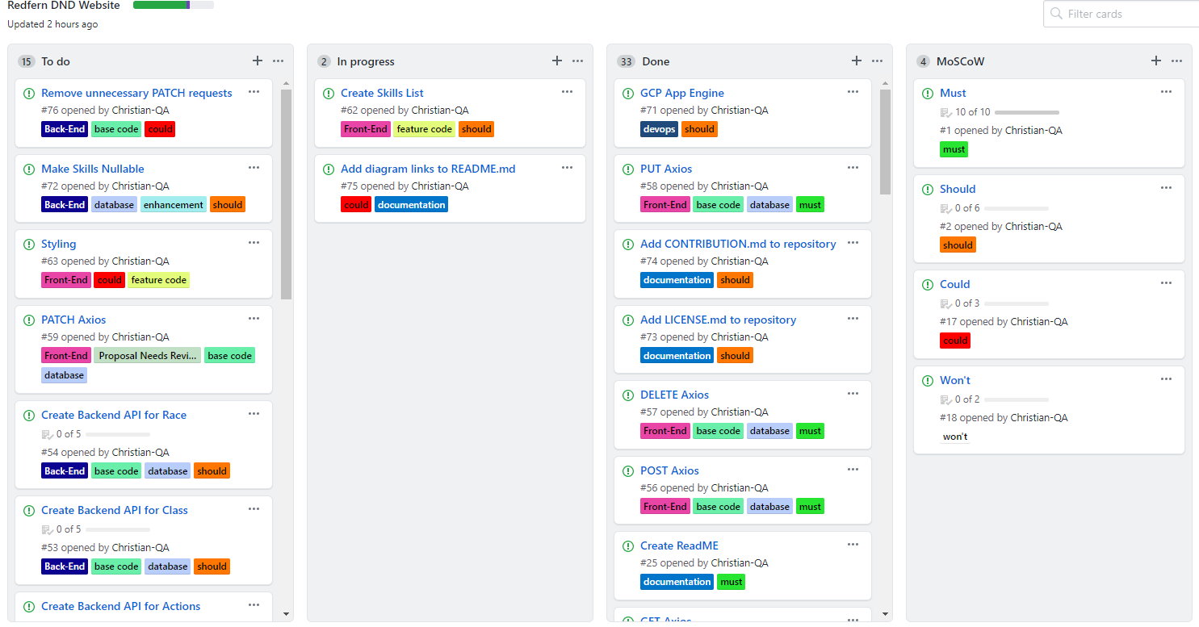
Kanban Board

Slide 7
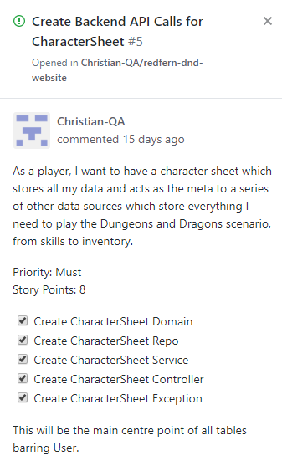
User Story Notes
The notes are all in User Story format.
This tells what needs to be done from the perspective of the user, driving the development towards a more user friendly release rather than simply something which works.
Priority uses the MoSCoW Method.
Every note has a Story Point value.
Checklist present if applicable.

Slide 8
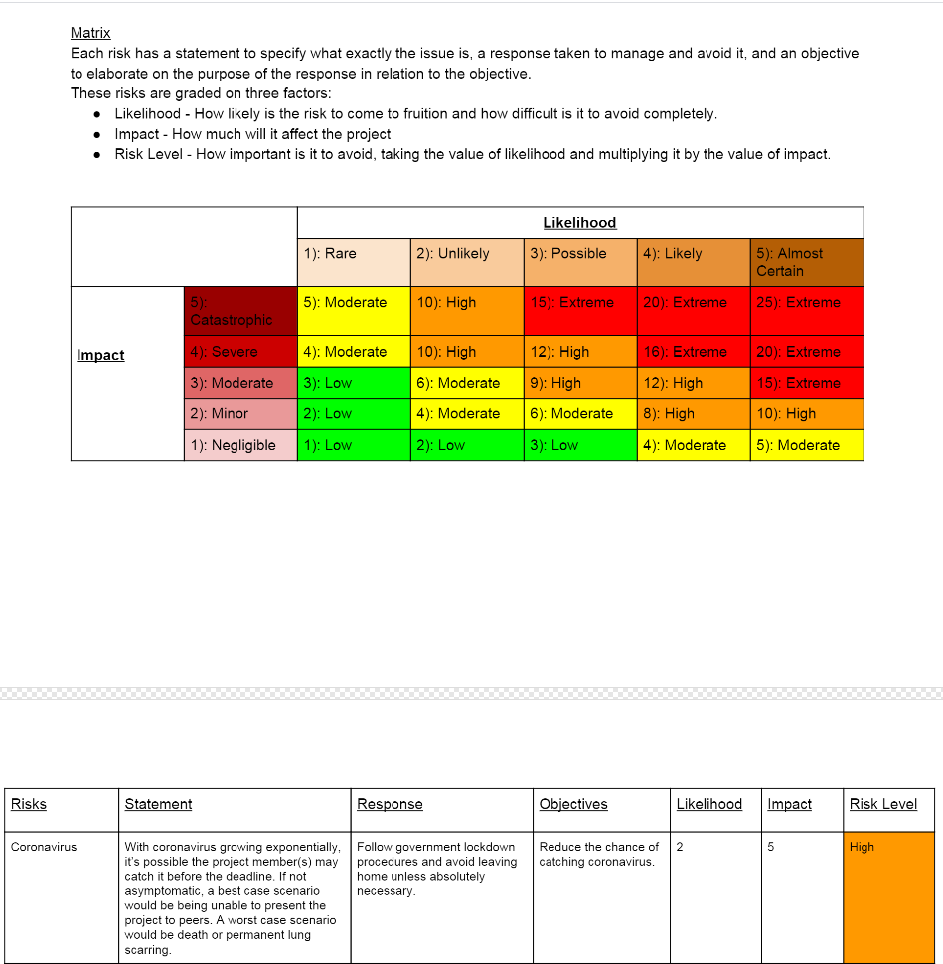
Risk Assessment
A risk assessment was made before development began.
The risks were outlined and given a risk level according to a matrix.

Slide 9
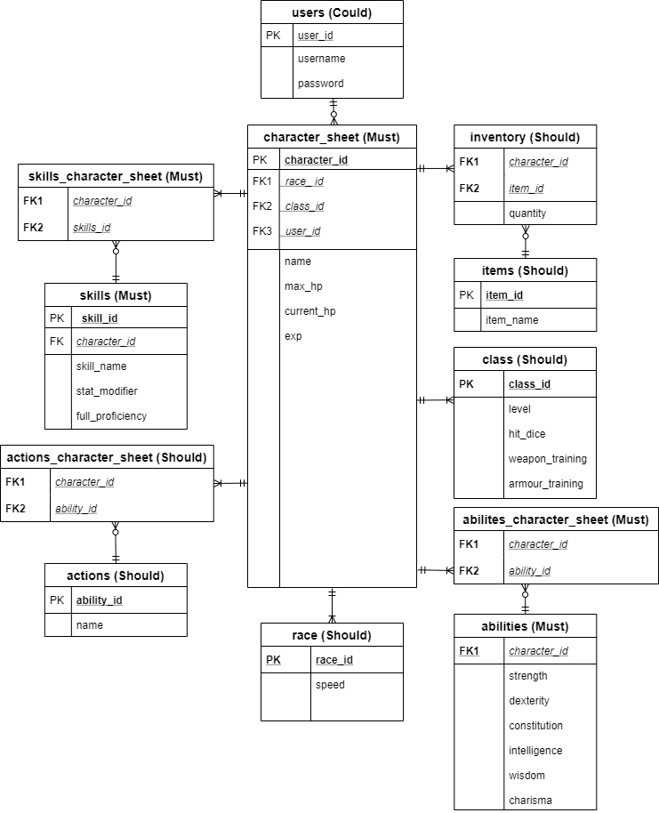
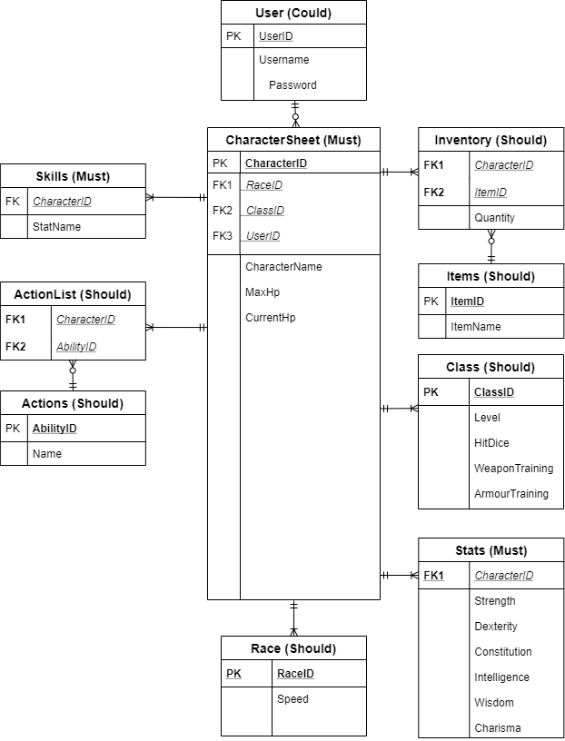
ERD
Old on the Left
New on the Right

Slide 10
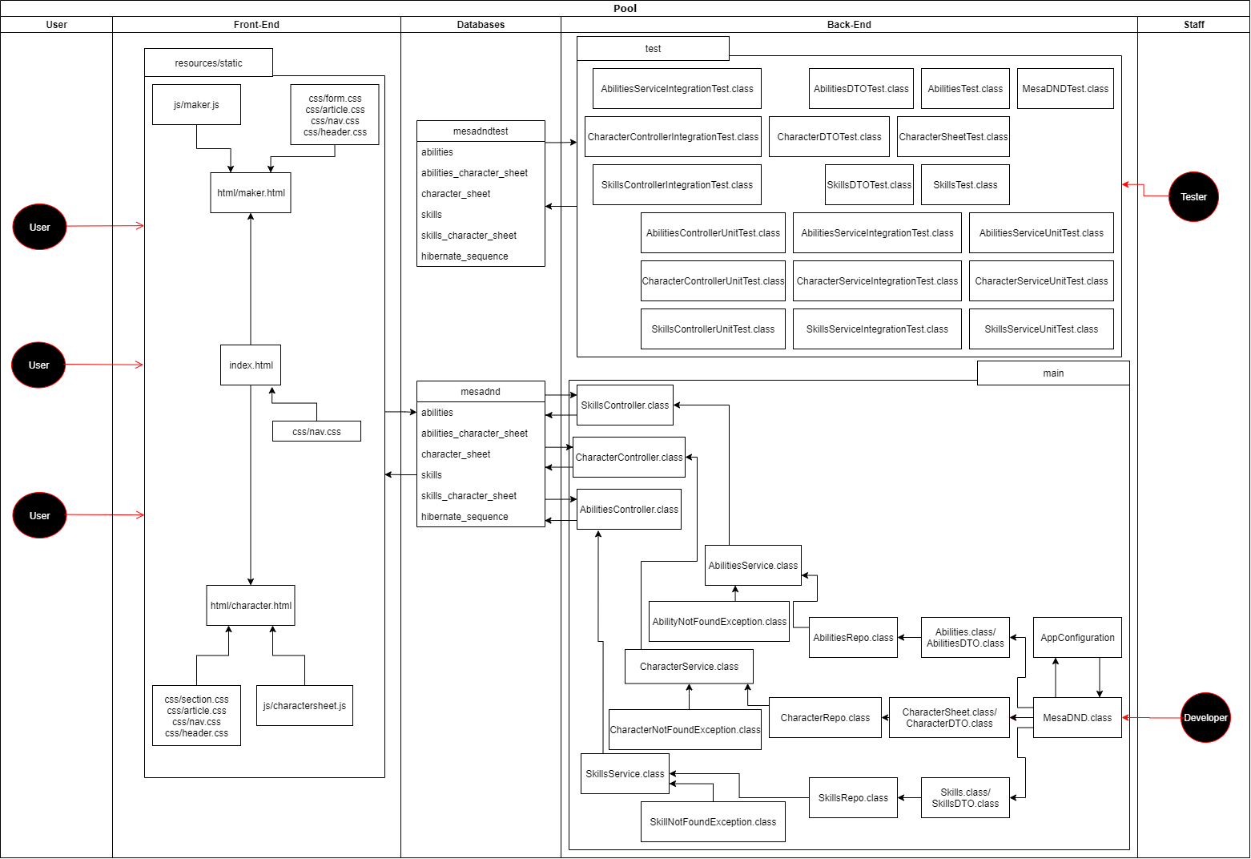
UML

Slide 11
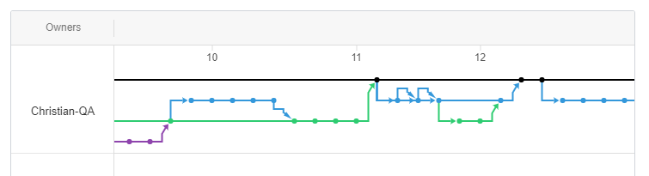
GitHub Version Control
GitHub was used for version control.
The project started with a basic Master, Developer and Feature branch model.
Git Flow was utilised near the end of the pre-alpha development stages of the backend, expanding on the model by introducing Bugfix, Hotfix and Support Branches.

Slide 12
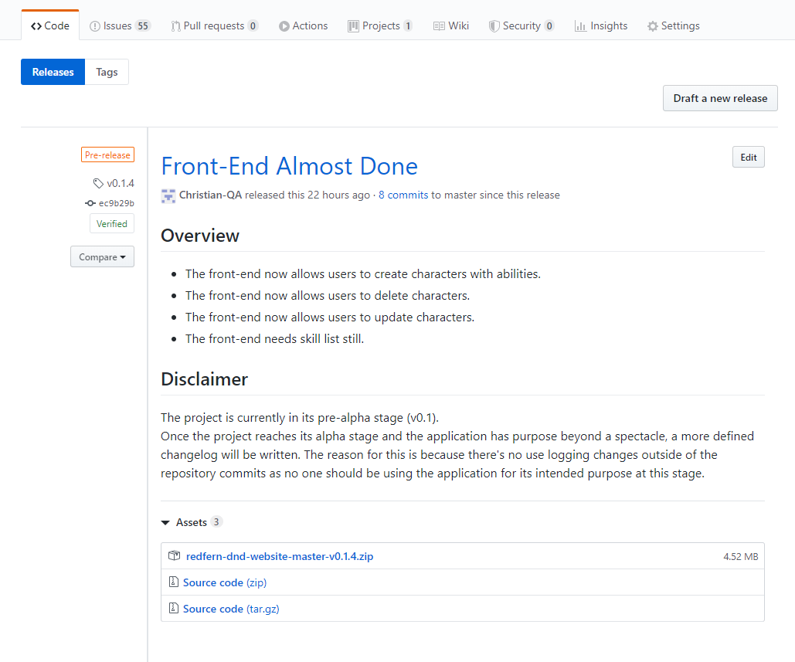
GitHub Release
Releases we added to the repository periodically to show all of the working builds.
These releases contain the released copies of the project and a brief changelog.

Slide 13
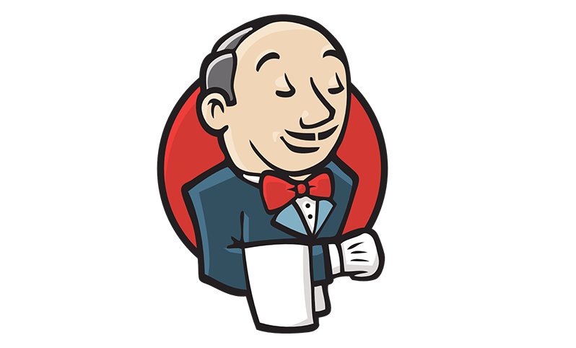
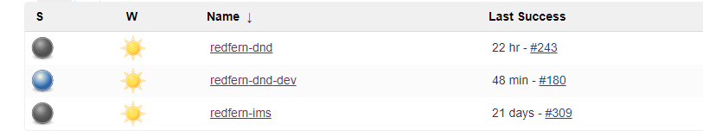
CI Pipeline
Jenkins is used to create a continuous integration pipeline.
This:
Cleans, packages and runs the tests for the project.
Sends the project to SonarQube.
Sends the project to the Nexus Repository.

Slide 14
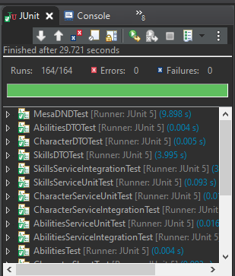
Unit and Integration Tests
The project utilises JUnit for unit tests, JUnit with Mockito and Selenium with TestNG for Integration tests, and SonarQube for coding style tests.
There is a total of 163 tests within the program, boasting 88% method and 88.9% line coverage.

Slide 15
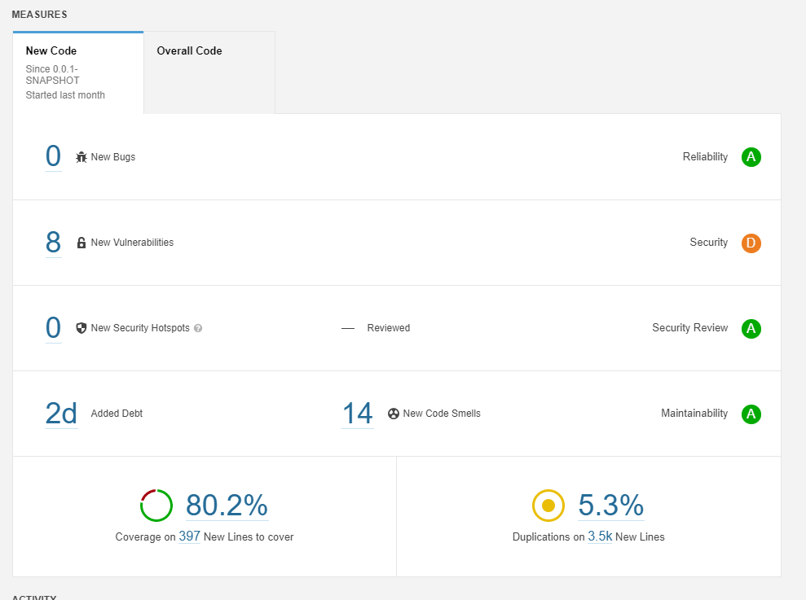

SonarQube
SonarQube was used for static analysis and coding style tests.

Slide 16
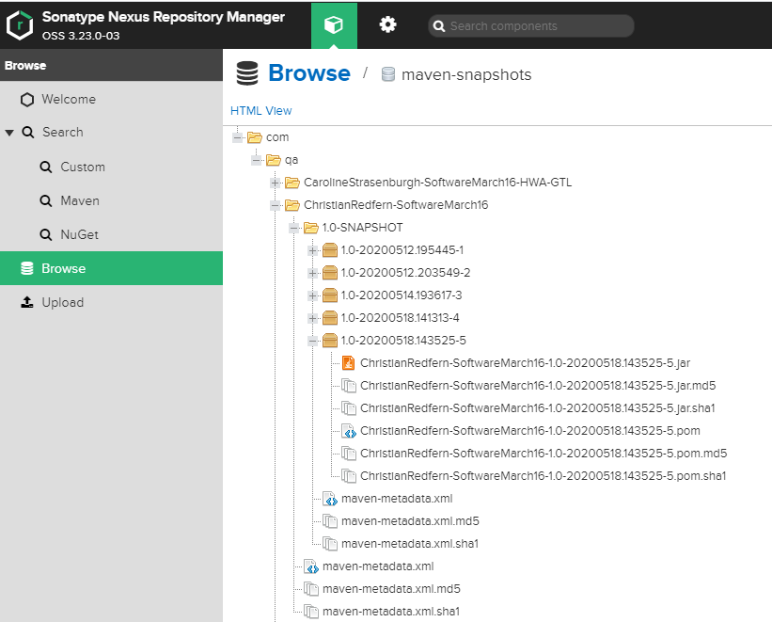
Nexus
Nexus is used as the artifact repository, under the artifact ID ‘ChristianRedfern-SoftwareMarch16’

Slide 17
Demo

Slide 18
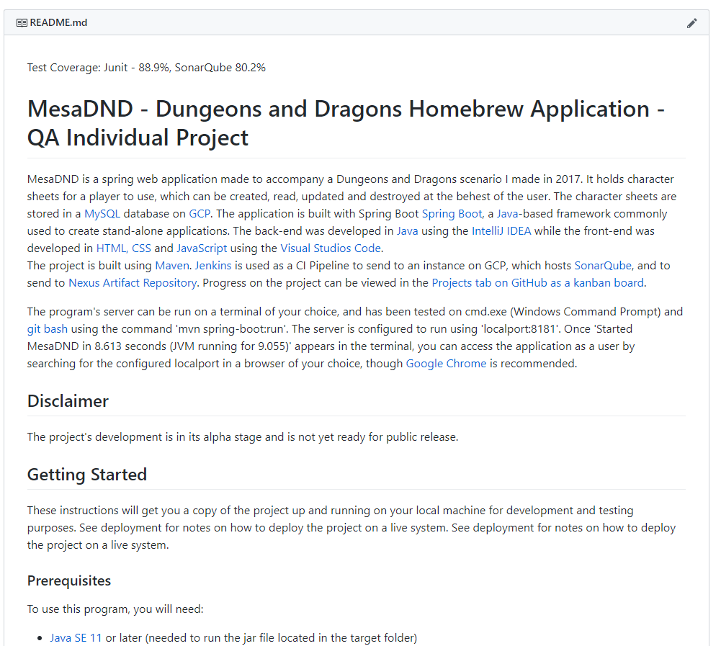
README.md
The project repository contains an extensive README for those who wish to use the application or develop it further.

Slide 19
Retrospective and Conclusion
The project went extremely well.
The back-end was fully completed, and is ready for expansion.
The front-end is fully functional, though needs to be stylised.
The project’s testing meets industry standard.
The project’s documentation is extensive.
For more information: https://github.com/Christian-QA/redfern-dnd-website

Slide 20
Questions?

